Slide 1

ASE-230 Final
Group Members: Brandon Cooper, Logan Poe, Ben Acuff, Ben Molloy

Slide 2
About Bidorama
The proposed auction website aims to provide users with a dynamic platform for buying and selling items through online auctions.
01
Users can bid on items of interest, benefit from discounted prices, and engage in a seamless auction experience.
02
The website differentiates itself by focusing solely on auctions, ensuring a user-friendly interface, and introducing innovative features to enhance the auction experience.
03

Slide 3
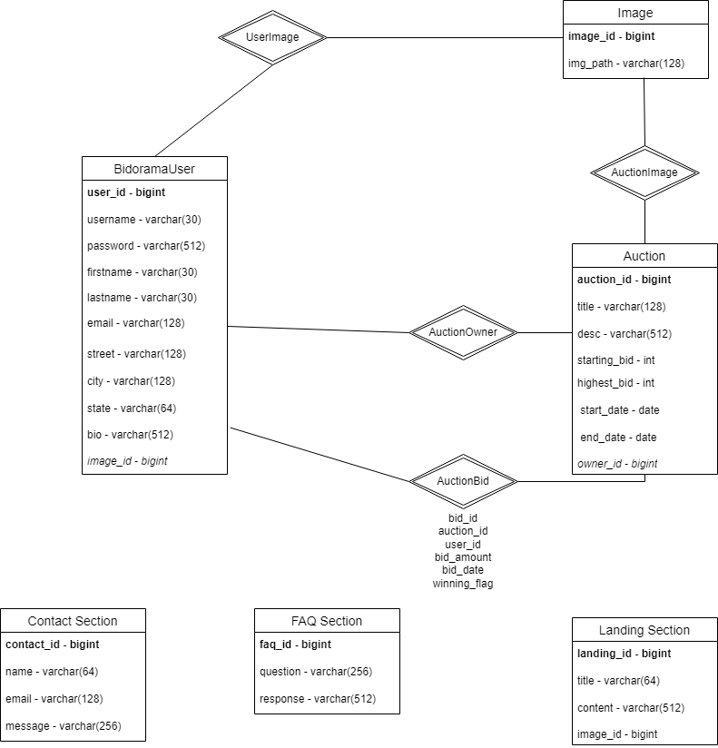
ER Diagram
Updated ER Diagram

Slide 4
Contributions
Brandon Cooper: Landing class instance, various DB queries, use sessions, member and admin areas
Logan Poe: Database queries for contact and FAQ, updated ER
Ben Acuff: Auctions page and detail page, DB queries for auctions
Ben Molloy: Login Queries, Sign Up Queries, Co-op Coding with others, UI elements, PPT Creation

